Slide 1
Summary
Git
Demo
Deployments
Discussion on workflow

Slide 2


Slide 3
version-control system
Distributed
tracking changes in computer files
Snapshots, Not Differences

Slide 4
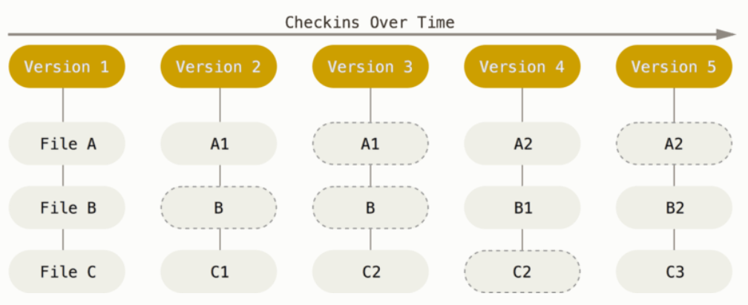

Slide 5
IT’s all local

Slide 6
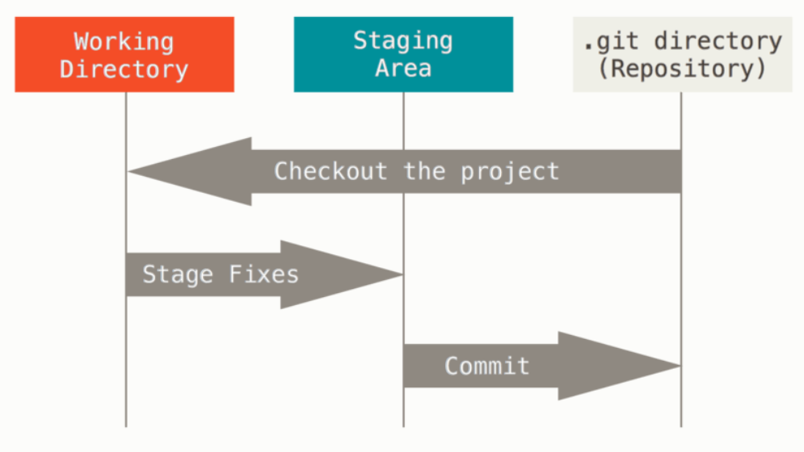

Slide 7
TERMINOLOGY
REPOSITORY: virtual storage of your project. it allows you to save versions of your code, which you can access when needed
Commit: individual change to a file (or set of files)
Branch independent line of development. it’s a set of commits and it serves as an abstraction for the edit/stage/commit process
master: default branch
https://git-scm.com/about

Slide 8
Workflow example

Slide 9
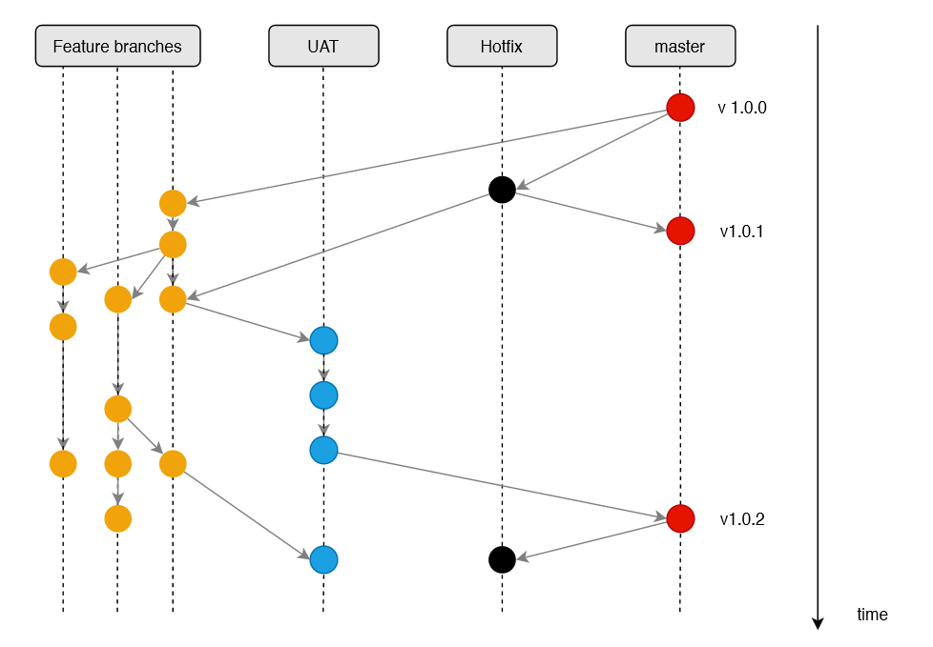

Slide 10
DEMO

Slide 11
DEPLOYMENTS

Slide 12
